Slide 1
Cardiomyopathy
Barkum Hadi Zafira 01141113
Mukoro D. Ese 01141011
Oyebode P. Ifeoluwa 01120580
Sobo A. Motunrayo 01130558

Slide 2
Definition
A heterogeneous group of diseases of the myocardium associated with mechanical and/or electrical dysfunction that usually (but not invariably) exhibit inappropriate ventricular hypertrophy or dilatation and are due to a variety of causes that frequently are genetic.
It is estimated that cardiomyopathy accounts for 5–10% of the heart failure in the 5–6 million patients carrying that diagnosis in the United States. (2001)

Slide 3
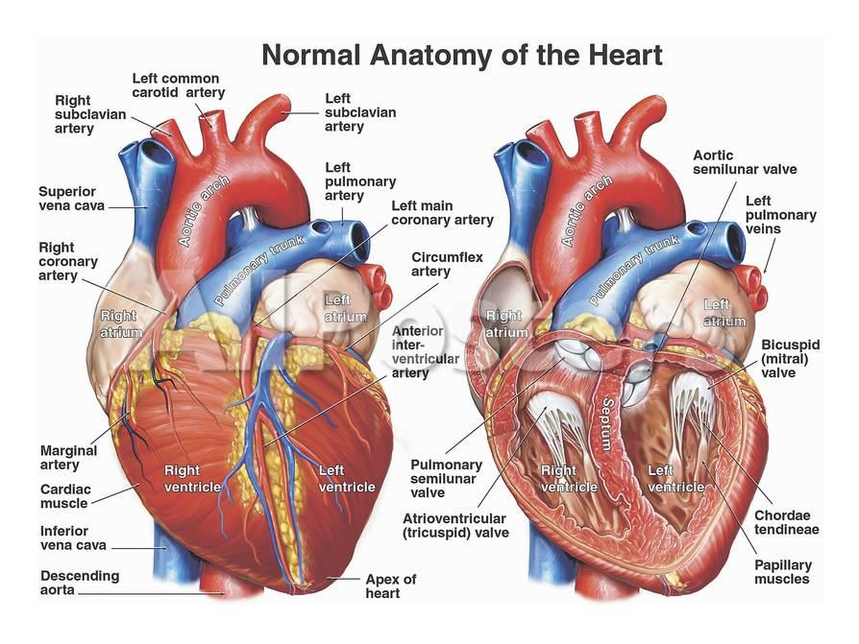
Normal Anatomy of the heart

Slide 4
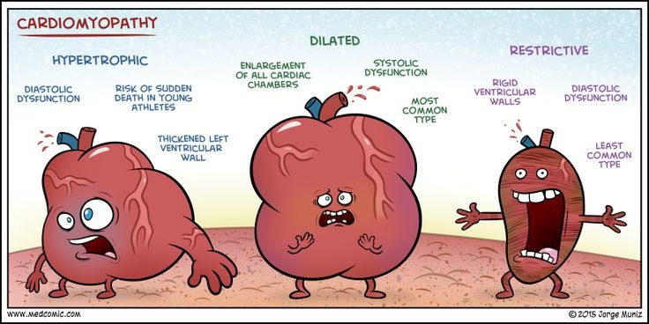
Classical TYPES OF CARDIOMYOPATHY

Slide 5
Classification into Primary and Secondary forms
PRIMARY
Genetic
Hypertrophic cardiomyopathy
Arrhythmogenic right ventricular cardiomyopathy
LV non-compaction
Ion Channelopathies
Dilated cardiomyopathy
Restrictive cardiomyopathy
Acquired
Stress cardiomyopathy
Myocarditis
Ischemic cardiomyopathy
SECONDARY
Metabolic/storage
Fabry's disease and Hemochromatosis
Endomyocardial
Endomyocardial fibrosis and Hypereosinophilic syndrome
Endocrine
Diabetes mellitus, Hyperthyroidism and Acromegaly
Cardiofacial
Noonan syndrome
Neuromuscular
Muscular dystrophy and Friedreich's ataxia Others
Obesity-associated cardiomyopathy

Slide 6
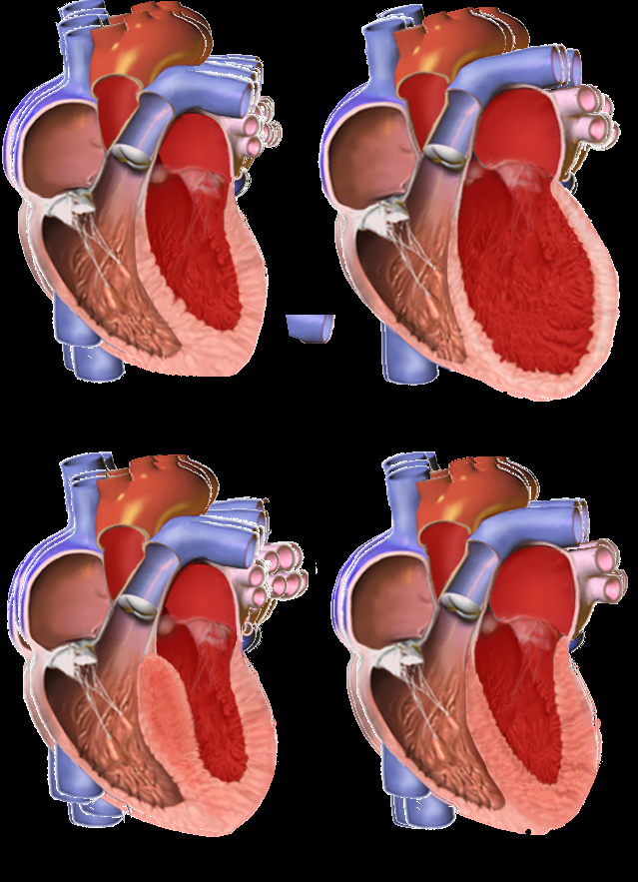
Classification
For purposes of general diagnosis and therapy, however, three time-honored clinical, functional, and pathologic patterns are recognized:
Dilated cardiomyopathy (including arrhythmogenic right ventricular cardiomyopathy)
Hypertrophic cardiomyopathy
Restrictive cardiomyopathy

Slide 7
DILATED CARDIOMYOPATHY
Dilated cardiomyopathy is characterized by progressive cardiac dilation and contractile (systolic) dysfunction.
Characteristics include four-chamber hypertrophy and dilation and both right- and left-sided intractable heart failure.
Some forms are associated with mutant cytoskeletal proteins, such as dystrophin or desmin; mutations of sarcomeric proteins, such as cardiac myosin heavy chain; and other muscle proteins, such as actin.
A multi-etiologic variant of dilated cardiomyopathy, known as peripartum cardiomyopathy, is associated with the latter stages of pregnancy and the period extending from weeks to months postpartum.

Slide 8
Arrhythmogenic Right Ventricular Cardiomyopathy
Arrhythmogenic right ventricular cardiomyopathy is an autosomal dominant disorder of the cardiac muscle; it classically manifests with right-sided heart failure and rhythm disturbances that can cause sudden cardiac death.
Morphologically, the right ventricular wall is severely thinned owing to myocyte replacement by massive fatty infiltration and lesser amounts of fibrosis

Slide 9
HYPERTROPHIC CARDIOMYOPATHY
The heart is thick-walled, heavy, and hypercontractile, in striking contrast with the flabby, poorly contractile heart in Dilated Cardiomyopathy.
Hypertrophic Cardiomyopathy is marked by massive myocardial hypertrophy without ventricular dilation. Classically, there is disproportionate thickening of the ventricular septum.

Slide 10
RESTRICTIVE CARDIOMYOPATHY
Restrictive cardiomyopathy is characterized by a primary decrease in ventricular compliance, resulting in impaired ventricular filling during diastole (simply put, the wall is stiffer).
Restrictive cardiomyopathy can be idiopathic or associated with systemic diseases that also happen to affect the myocardium, for example radiation fibrosis, amyloidosis, sarcoidosis, or products of inborn errors of metabolism.

Slide 11
Takotsubo Cardiomyopathy (Broken Heart Syndrome)
Broken heart syndrome is caused by extreme emotional or physical stress.
Another rare form of cardiomyopathy is LEFT VENTRICULAR NON-COMPACTION: it is a congenital disorder characterized by a distinctive “spongy” appearance of the ventricles.

Slide 12
CAUSES OF CARDIOMYOPATHY
DILATED CARDIOMYOPATHY
Genetic
Alcohol
Peripartum
Myocarditis
Hemochromatosis
Chronic anemia
Doxorubicin (Adriamycin)
Sarcoidosis
HYPERTROPHIC CARDIOMYOPATHY
Genetic
Friedreich ataxia Storage diseases
Infants of diabetic mothers
RESTRICTIVE CARDIOMYOPATHY
Amyloidosis
Radiation-induced fibrosis

Slide 13
Clinical presentation
Restrictive Cardiomyopathy
Shortness of breath
Progressive exercise intolerance
Orthopnea
Fatigue
Weight loss, cardiac cachexia
Paroxysmal nocturnal dyspnea
Abdominal discomfort and liver tenderness
Chest pain primarily in patients with amyloidosis or due to angina
Palpitation
Hepatmegaly
Dilated cardiomyopathy
fatigue
Dyspnea
Orthopnea, paroxysmal nocturnal dyspnea
Increasing edema, weight or abdominal girth
Systolic regurgitant murmurs
Tachycardia
Gallops
Irregularly irregular rhythm
Hypertrophic Cardiomyopathy
Sudden cardiac death is the most devastating presenting manifestation
Dyspnea
Syncope and presyncope
Angina
Palpitation
Orthopnea
CHF
Dizziness

Slide 14
investigation
Complete blood count
Thyroid function test
Cardiac biomarkers
B type natriuretic peptide assay
Chest radiography
balloon appearance of the heart and pulmonary congestion
Echocardiography
Cardiac MRI
Electrocardiography (ECG)
DCM- sinus tachycardia and arrythmia
HCM- left ventricular hypertrophy and psuedo Q wave
RCM- low voltage, conduction disturbance and Q waves
Liver function test

Slide 15
Preventive measures
You can help to reduce the effects of cardiomyopathy and the risk of more heart problems by making some lifestyle changes:
Be smoke free
Eat less salt: salt causes the body to retain fluid which can build up and put more strain on your heart and increase the risk of high blood pressure.
Limit alcohol: alcohol; can damage the heart
Do regular light to moderate intensity physical activity: such as walking , cycling, lifting weights, and stretching everyday. Do what you can do without getting breathless or overtired. Also avoid strenuous activity.
A healthy diet: fruits and vegetables and grains {whole grain products}. Choose foods that are low in saturated fat and cholesterol.
Loose excessive weight
Get enough rest and reduce stressing yourself unnecessarily
Get regular check ups from the doctor
Inherited types of cardiomyopathy cannot be prevented

Slide 16
MANAGEMENT
People who have cardiomyopathy but no signs or symptoms may not need treatment. Sometimes dilated cardiomyopathy that comes on suddenly may even go away on its own.
For others treatment is needed. Treatment depends on the type of cardiomyopathy; the severity of the symptoms and complications and the age and overall health
The main goals of treating cardiomyopathy include;
Managing any conditions that cause or contribute to the disease
Controlling signs and symptoms so that you can live as normally as possible
Stopping the disease from getting worse
Reducing complications and the risk of sudden cardiac arrest

Slide 17
NON SURGICAL Treatment
Lower the blood pressure: ACE inhibitors, angiotensin II receptor blockers, beta blockers, and calcium channel blockers.
Reduce the heart rate: beta blockers, digoxin, antiarrythmics
Balance electrolytes: aldosterone blockers
Use of diuretics
prevent blood clots from forming: anti coagulants or “blood thinners”
Reduce inflammation with corticosteroids

Slide 18
SURGICAL TREATMENT
Septal myectomy: it is an open heart surgery used for people who have obstructive hypertrophic cardiomyopathy and severe symptoms. This surgery is generally used for younger patients and for those who’s drugs are not working. A surgeon removes the part of the thickened septum that’s bulging into the left ventricle this improves blood flow through the heart and out of the body. The removed tissue doesn’t grow back. The surgeon can also repair or replace the mitral valve at the same time, if needed.
Surgically implanted devices:
a pacemaker is a perfect example . A small device that is placed under the skin of the chest or abdomen to help control arrhythmias. It uses electrical pulses to prompt the heart to beat at a normal rate
Cardiac resynchronization therapy(CRT) device: it coordinates contractions between the hearts left and right ventricles.
LAVD: a left ventricular assist device helps the heart pump blood to the body. It can be used as long term therapy or as short term therapy for people who are waiting for heart transplants.
ICD: Implantable cardioverter defibrillator helps control life threatening arrhythmias that may lead to sudden cardiac arrest. It is implanted in the chest or abdomen and connected to the heart with wires. If the ICD senses a dangerous change in heart rhythm, it will send and electric shock to the heart to restore a normal heartbeat.
Heart transplant: this is replacement of the diseased heart with a healthy heart from a deceased donor. This is the final resort for people with end stage heart failure.

Slide 19
complications
Heart attack failure: the heart cannot pump enough blood to meet the body's needs
Blood clots: because the heart cannot pump effectively , blood clots form in the heart. When clots enter the blood stream, they can block the blood flow to other organs including the heart and the brain
Valve problems: because cardiomyopathy causes the heart to enlarge, the heart valves might not close properly. This can lead to a backward flow of blood
Cardiac arrest and sudden death: cardiomyopathy leads to abnormal heart rhythms. These abnormal heart rhythms can result I fainting or in some cases, sudden death if the heart stops breathing effectively.

Slide 20
Reference
Boudina, Sihem; Abel, Evan Dale (1 March 2010). "Diabetic cardiomyopathy, causes and effects". Reviews in endocrine & metabolic disorders. 11 (1): 31–39. doi:10.1007/s11154-010-9131-7. ISSN 1389-9155. PMC 2914514 . PMID 20180026.
Marian, A. J.; Roberts, Robert (1 April 2001). "The Molecular Genetic Basis for Hypertrophic Cardiomyopathy". Journal of molecular and cellular cardiology. 33 (4): 655–670. doi:10.1006/jmcc.2001.1340. ISSN 0022-2828. PMC 2901497 . PMID 11273720.
Acton, Q. Ashton (2013). Advances in Heart Research and Application: 2013 Edition. Scholarly Editions. ISBN 978-1-481-68280-0.
Towbin, JA (2014). "Inherited cardiomyopathies". Circulation journal : official journal of the Japanese Circulation Society. 78 (10): 2347–56. ISSN 1347-4820. PMID 25186923. Retrieved 26 December 2017.
Maron, Barry J.; Udelson, James E.; Bonow, Robert O.; Nishimura, Rick A.; Ackerman, Michael J.; Estes, N. A. Mark; Cooper, Leslie T.; Link, Mark S.; Maron, Martin S. (1 December 2015). "Eligibility and Disqualification Recommendations for Competitive Athletes With Cardiovascular Abnormalities: Task Force 3: Hypertrophic Cardiomyopathy, Arrhythmogenic Right Ventricular Cardiomyopathy and Other Cardiomyopathies, and Myocarditis: A Scientific Statement From the American Heart Association and American College of Cardiology". Circulation. 132 (22): e273–280. doi:

